Slide 1
Algorithms
Lecture 4
Recursive Time Complexity
Prantik Paul [PNP]
Lecturer
Department of Computer Science and Engineering
BRAC University

Slide 2
Solving Recurrences- Methods
Iteration Method
Recursion Tree Method
Master Theorem

Slide 3
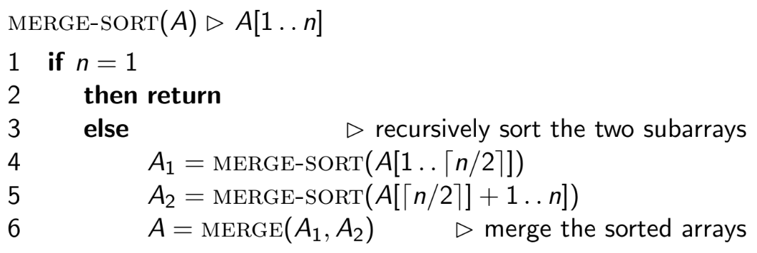
Merge Sort (Algorithm)

Slide 4
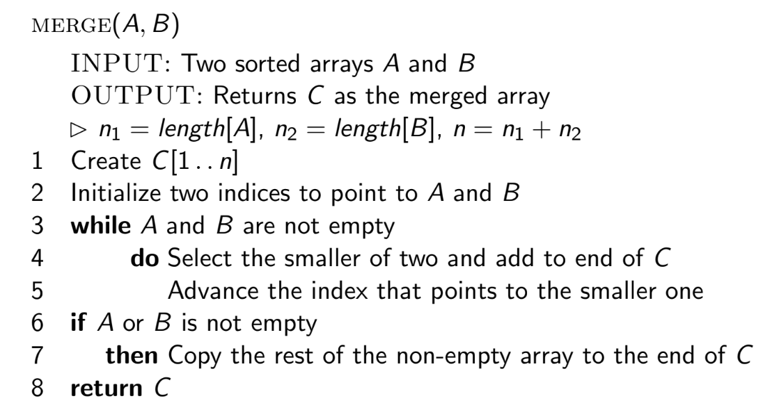
Merge (Algorithm)

Slide 5
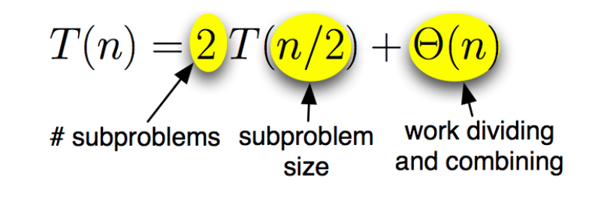
Merge Sort: Running Time

Slide 6
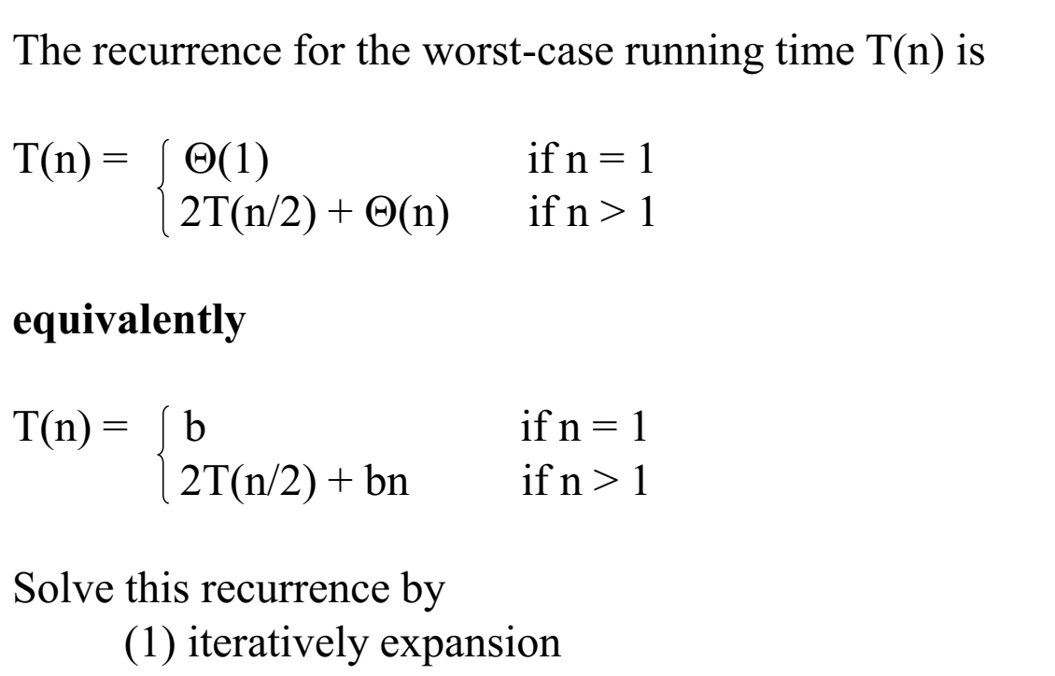
Merge Sort: Running Time

Slide 7
Iterative Approach
→ T(n) = T(n-1) + 1
= (T(n-2) + 1) + 1
= ((T(n-3) + 1) +1) + 1

Slide 8
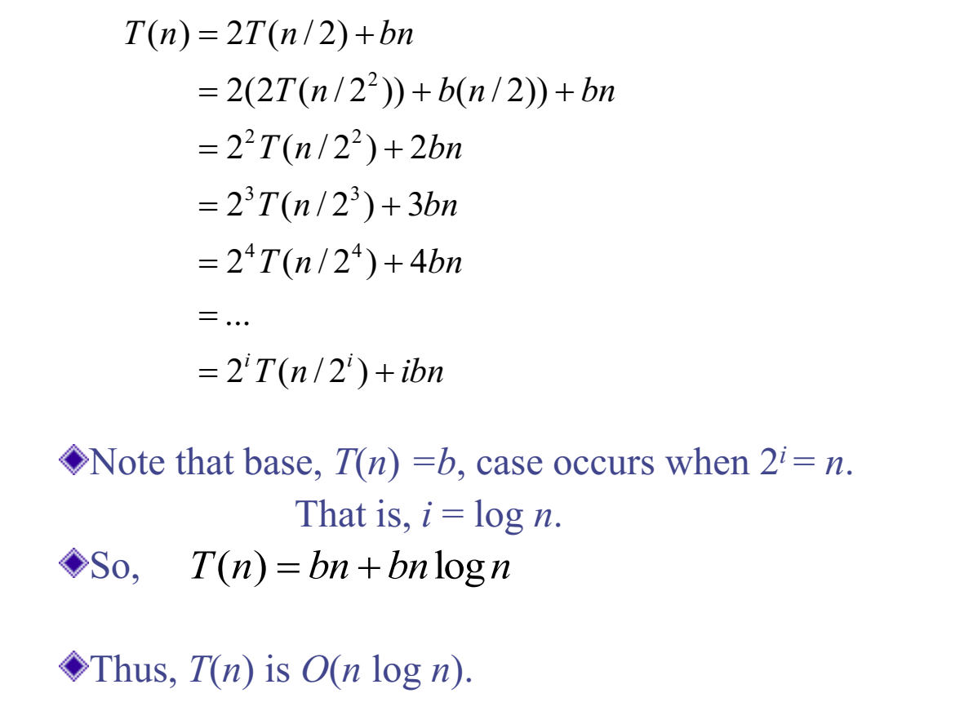
Merge Sort: Running Time
Refer to notes

Slide 9
Iteration Method
Try:
T(n) = 4T(n/2) + bn
T(n) = 3T(n/2) + bn

Slide 10
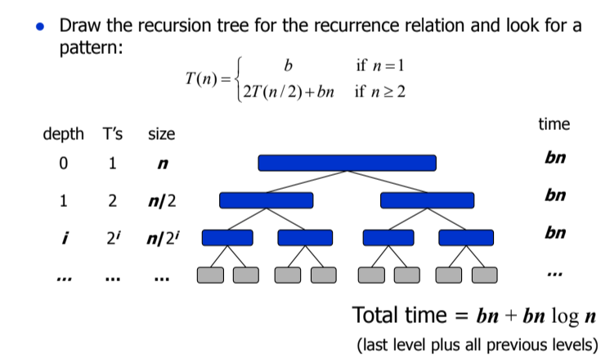
Recursion Tree Method

Slide 11
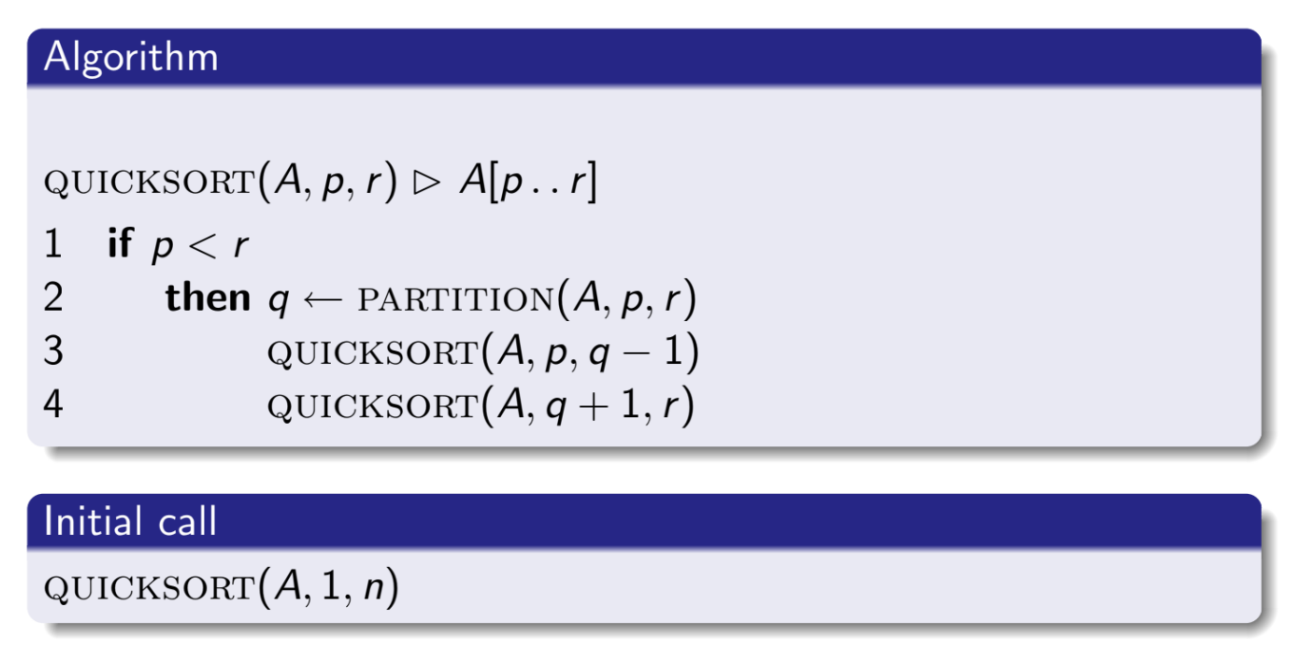
Quick Sort (Algorithm)

Slide 12
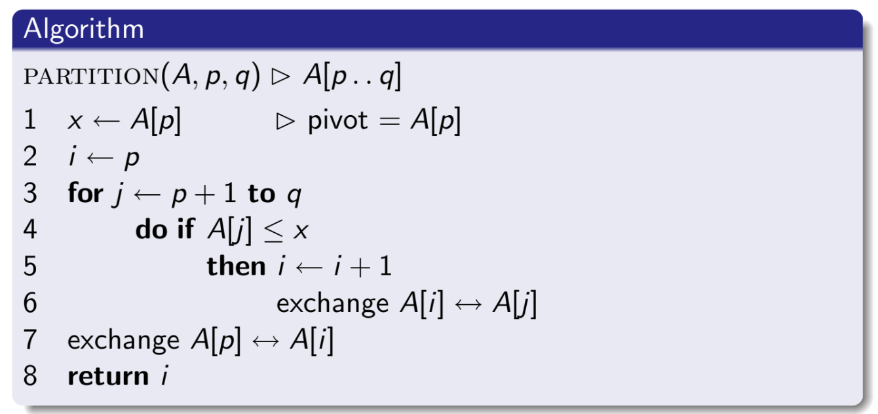
Partitioning (Algorithm)

Slide 13
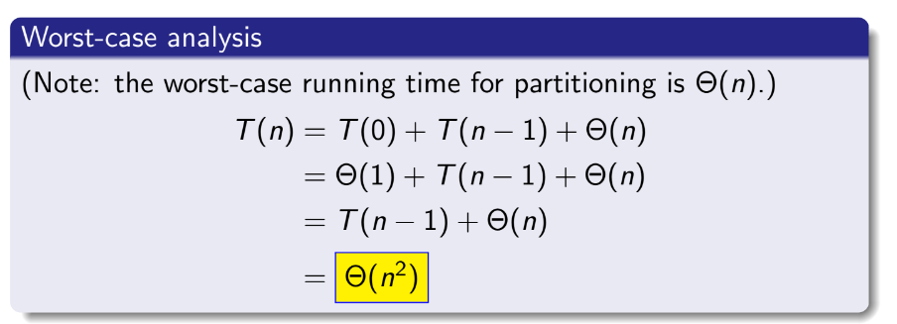
Quick Sort: Running Time

Slide 14
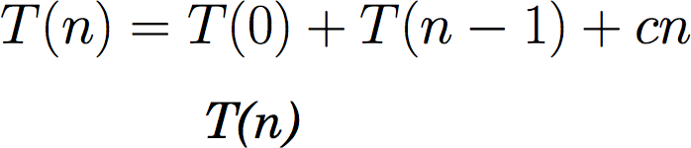
Quick Sort: Recursion Tree Worst Case

Slide 15
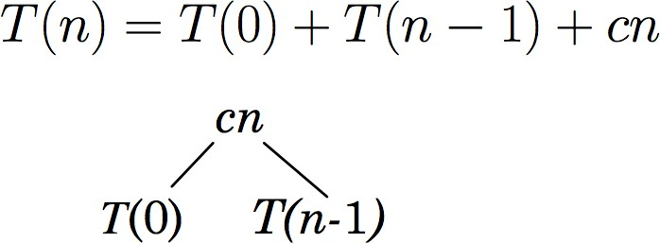
Quick Sort: Recursion Tree Worst Case

Slide 16
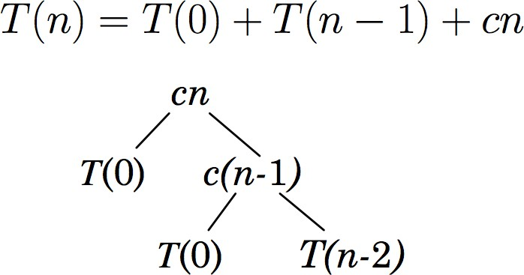
Quick Sort: Recursion Tree Worst Case

Slide 17
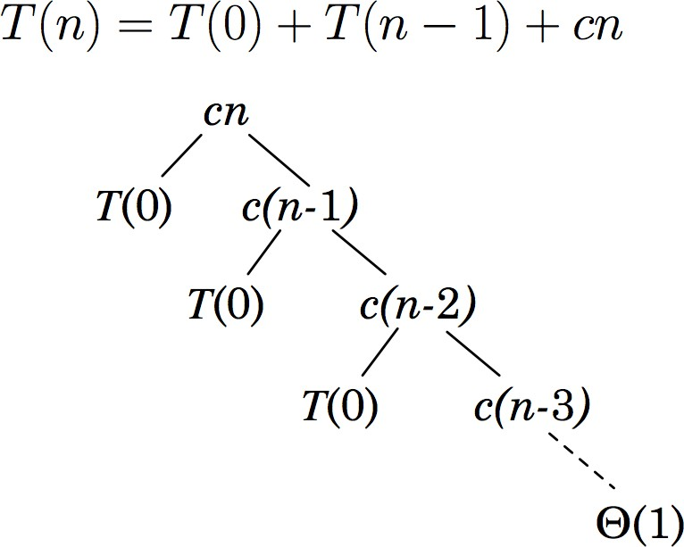
Quick Sort: Recursion Tree Worst Case

Slide 18
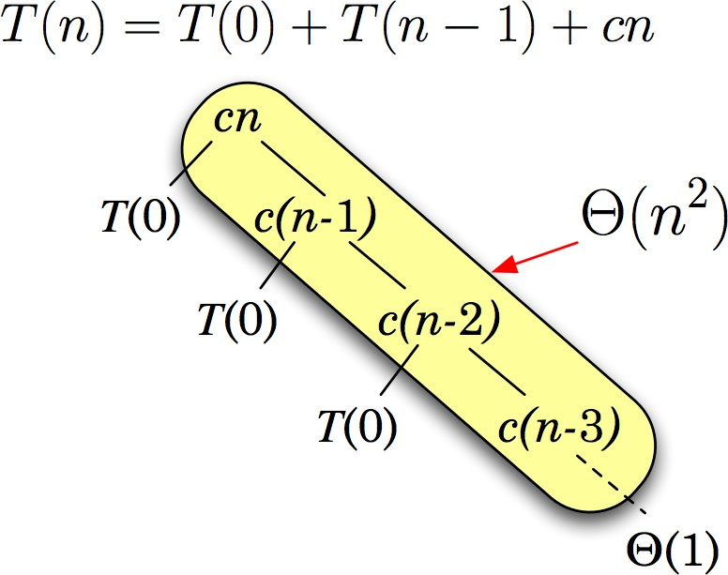
Quick Sort: Recursion Tree Worst Case

Slide 19
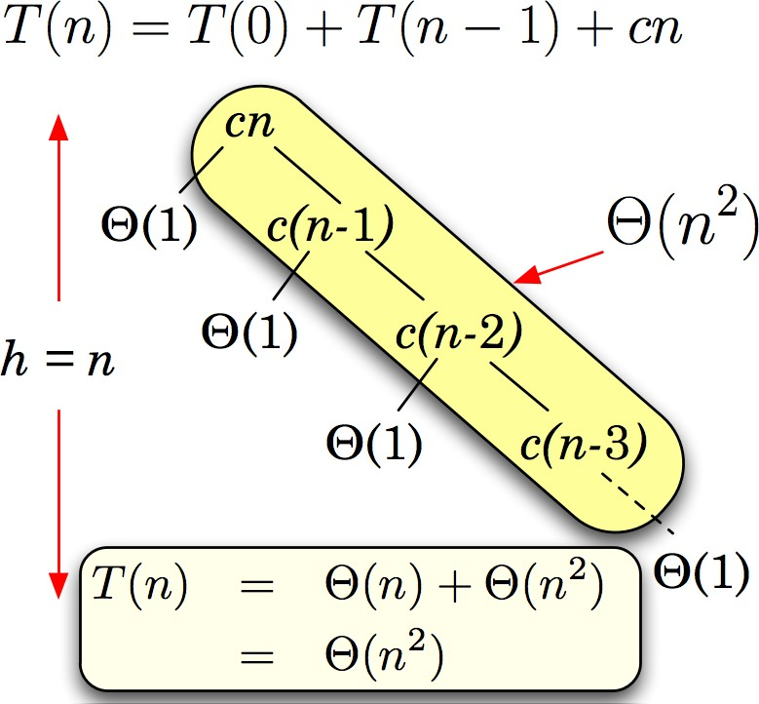
Quick Sort: Recursion Tree Worst Case

Slide 20
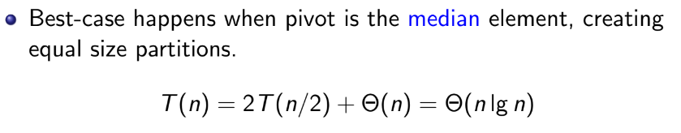
Quick Sort: Running Time (Best Case)

Slide 21
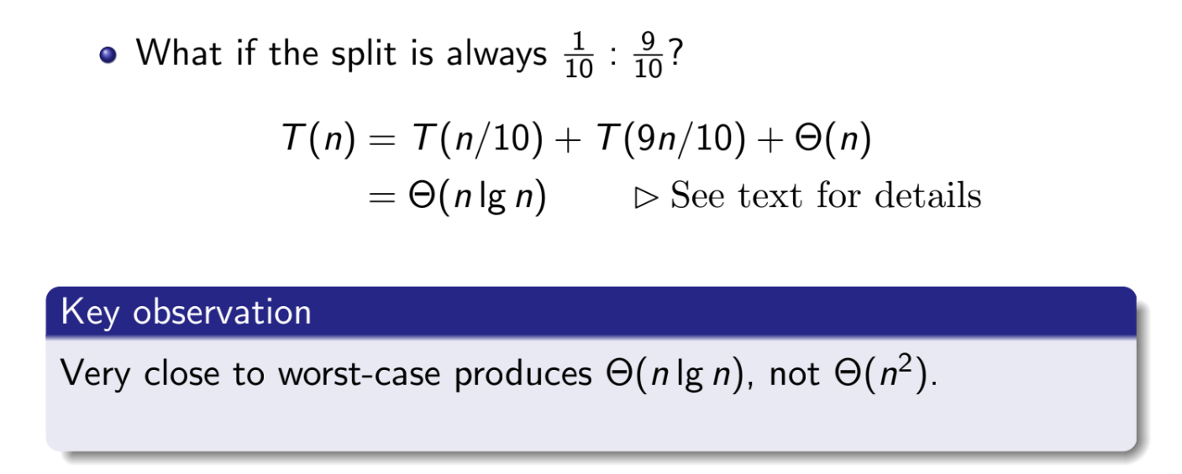
Quick Sort: Running Time (Almost Worst Case)
Refer to book

Slide 22
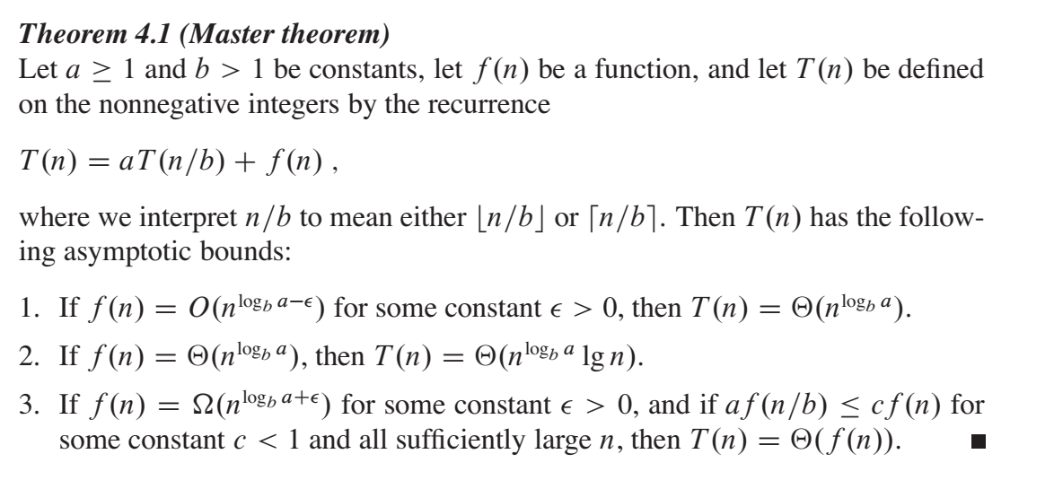
Master Theorem

Slide 23
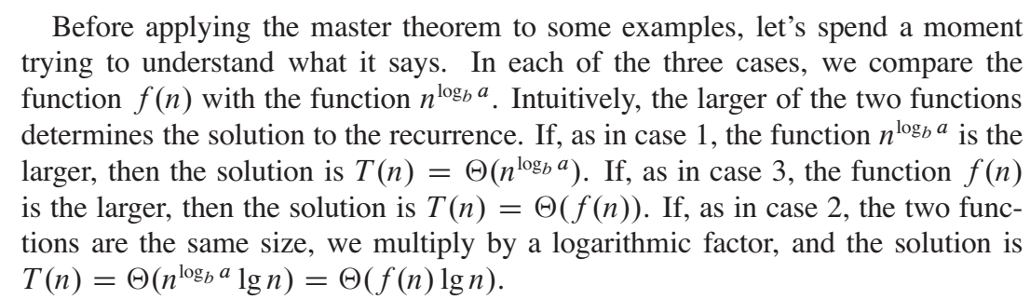
Master Theorem

Slide 24
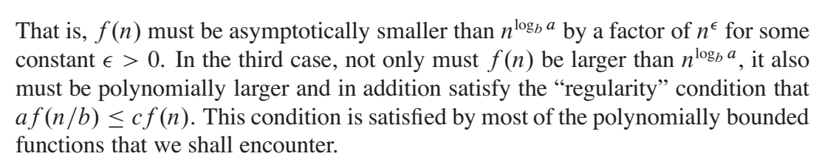
Master Theorem

Slide 25

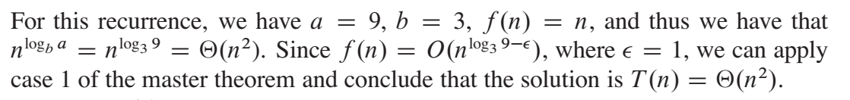
Master Theorem - Case 1 Example

Slide 26
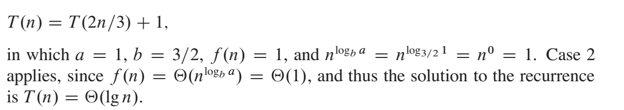
Master Theorem - Case 2 Example

Slide 27
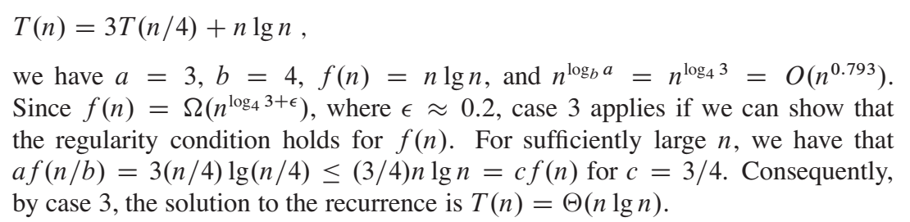
Master Theorem - Case 3 Example

Slide 28
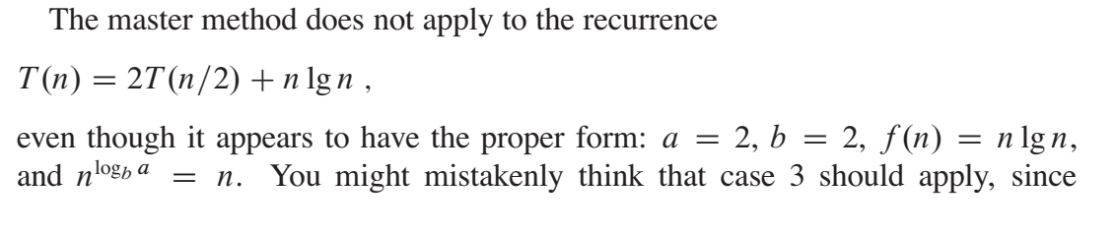
Master Theorem

Slide 29
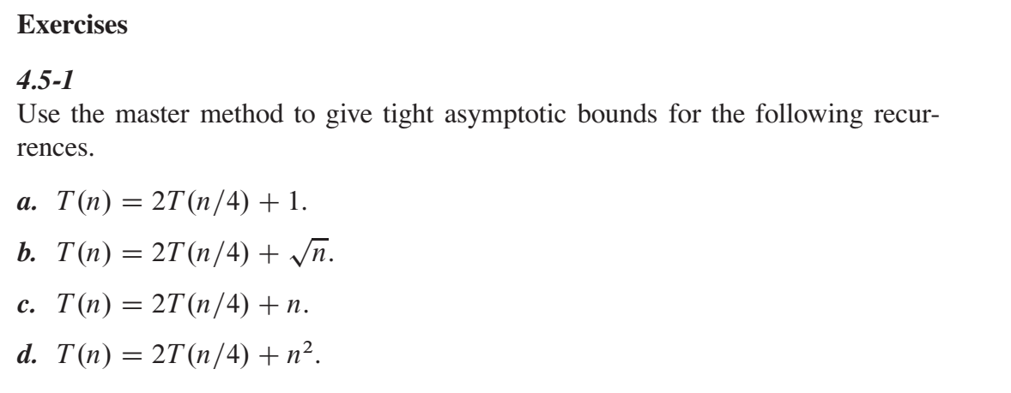
Master Theorem

Slide 30
Resources
CLRS Book:
Chapter 2.3.2 - Merge Sort Analysis
Chapter 4.4 - Recursion Tree Method
Chapter 4.5 - Master Method
Chapter 7.4 - Quicksort Analysis
Recursive Time Complexity Notes

